Slide 1
De l’Une à l’Autre
Towards Linked Data
in
Special Collections Cataloging
Regine Heberlein (Princeton University)
Notes:
Intro
Talk about Princeton’s participation in the Linked Data for Production initiative

Slide 2

LD4P@PUL
Joyce Bell (project lead)
Cataloging & Metadata Services Director
Jennifer Baxmeyer
Leader, Electronic Resources Team
Peter Green
Cataloging & Metadata Technology Specialist
Lidia Santarelli
Metadata Librarian, Modern Greek Specialty
Regine Heberlein
Principal Cataloger & Metadata Analyst, Rare Books
Tim Thompson ( -March 2017)
Metadata Librarian (Spanish/Portuguese Specialty)
Notes:
Who we are
(Many in the room will know this.) Our group is part of the Mellon-funded Linked Data for Production project, which includes six research libraries (Columbia, Cornell, Harvard, Library of Congress, Stanford, and Princeton). The purpose of the grant is to explore ways to move from MARC-based production workflows to production workflows based on linked open data (LOD). Each partner library works independently on a local use case, including data modeling and (in some cases) domain-specific ontology development.
LD4P is part of the “LD4” family, which includes the Mellon-funded Linked Data for Libraries (LD4L) (concluded), and LD4L-Labs (2016-2018, which focuses on creating production tools).
The two-year grant period for LD4P began in April 2016.

Slide 3

Notes:
Princeton is using (a selection from) the the Library of Jacques Derrida as its project test case. It is an author library of nearly 19k items, acquired by Princeton University Library in 2014.
<Jacques Derrida was a French philosopher, He is one of the major figures associated with post-structuralism and postmodern philosophy. The collection has met with correspondingly high interest from scholars.>
The collection includes Derrida's working library as well as books belonging, jointly or separately, to Jacques and (his wife) Marguerite Derrida and in a handful of cases,, their two sons, Jean and Pierre. It consists of monograph volumes, serial issues, offprints, clippings, and typescripts accumulated in the course of Jacques and Marguerite's professional activities, as well as books representing the family's leisure reading.

Slide 4
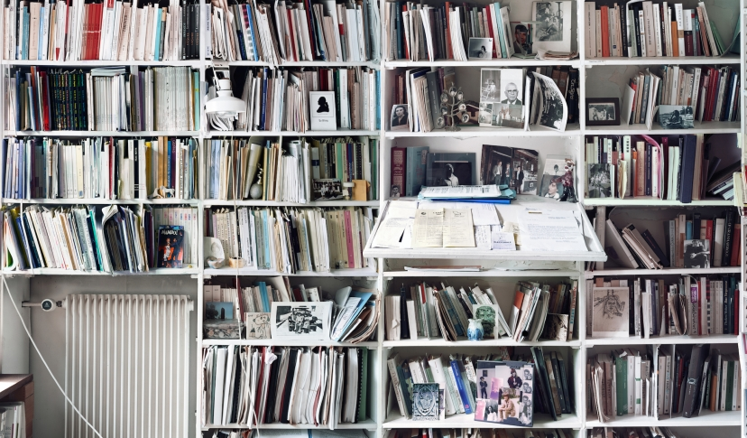
Notes:
What makes the collection very interesting from a linked data perspective is that it embodies many (and) different types of relationships that aren’t easy to either expose or (let alone) make functional in a library environment with our current descriptive tools.
Among them are, for example, Derrida’s extensive marginalia and insertions, which for those interested in studying Derrida’s reading habits or intellectual formation (among other things) represent a record of a dialog between Derrida and the text (or its author/translator/editor/subject). (There is currently another project at Princeton exploring this, called “Derrida’s Margins” and led by Katie Chenoweth.)
Another interesting type of relationship is the shelving location of the books, which is meaningful in that where a book was kept (for example, in the Studio or not) and “who” its shelf neighbors were contains information about how it was used by Derrida. Archivists call this type of information, which is not on the resource itself, Context. The presence of substantial archival context prompted us to describe the collection in a finding aid (rather than individual MARC records). That way we were able to display the original shelf order and to allow users to sort by it. Nevertheless, the functionality is of course limited (to browse lists).
Last not least, To get to the LD4P use case. The collection contains a large run (over 6k) of books gifted and inscribed to Derrida (and members of his household). (Derrida famously never threw away a book and kept even those he never opened.) There has been active scholarly interest in these dedications because they represent a physical manifestation of Derrida’s reader network and intellectual influence. Currently, this sort of information is buried in a note in the record, as I will show in just a bit, and we have no mechanisms to include it in our discovery functionality.

Slide 5
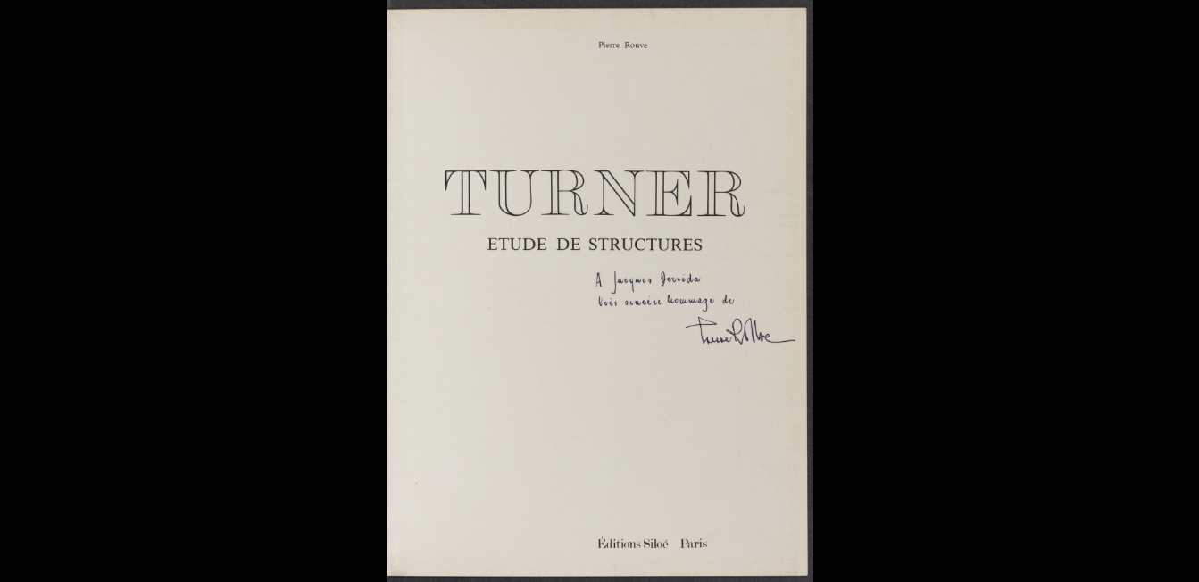
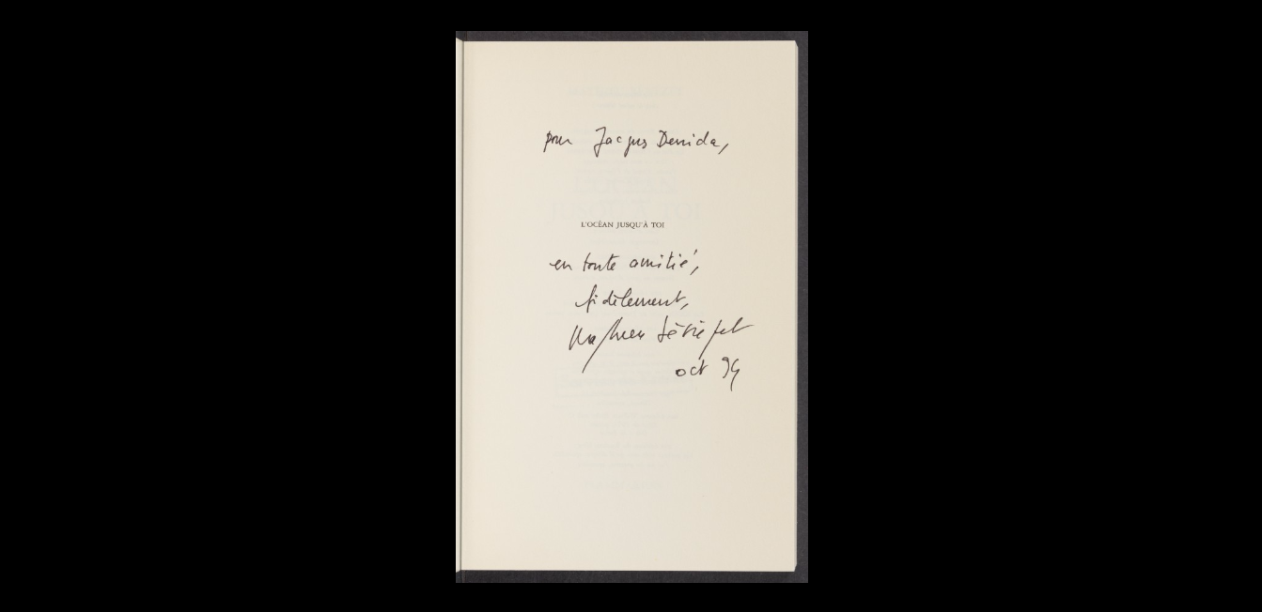
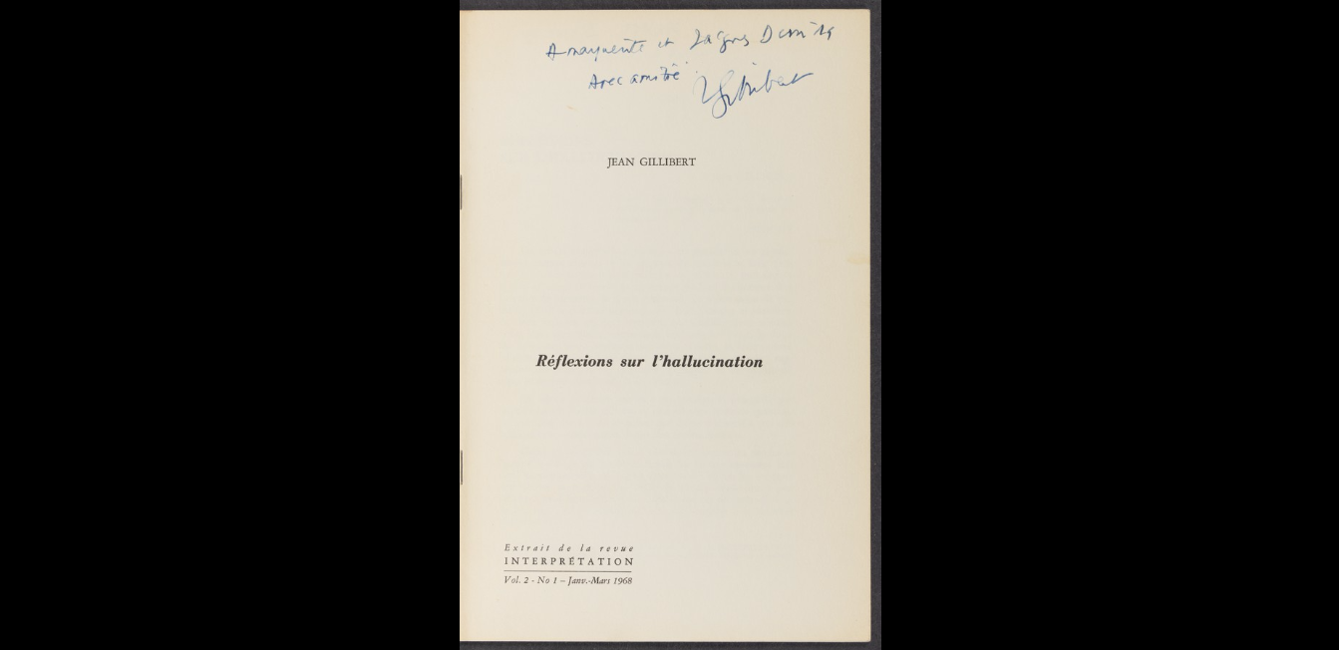
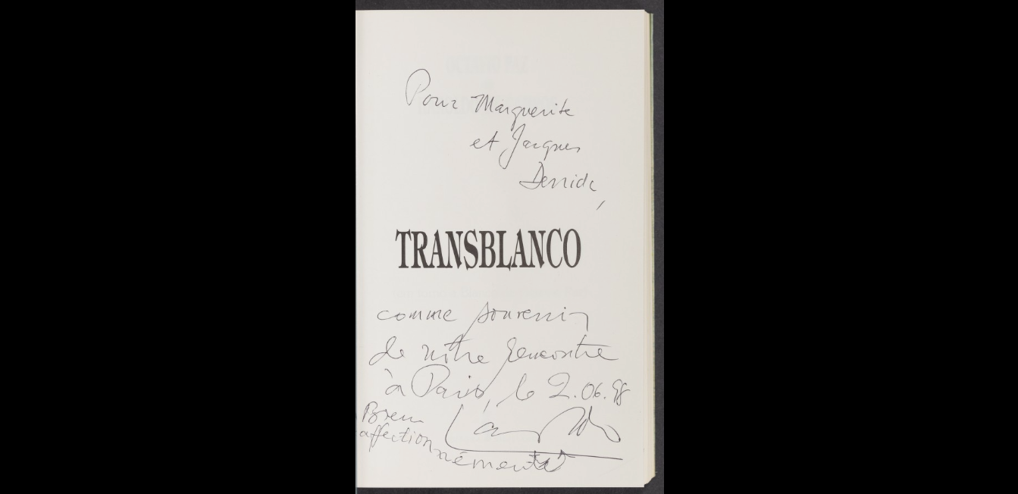
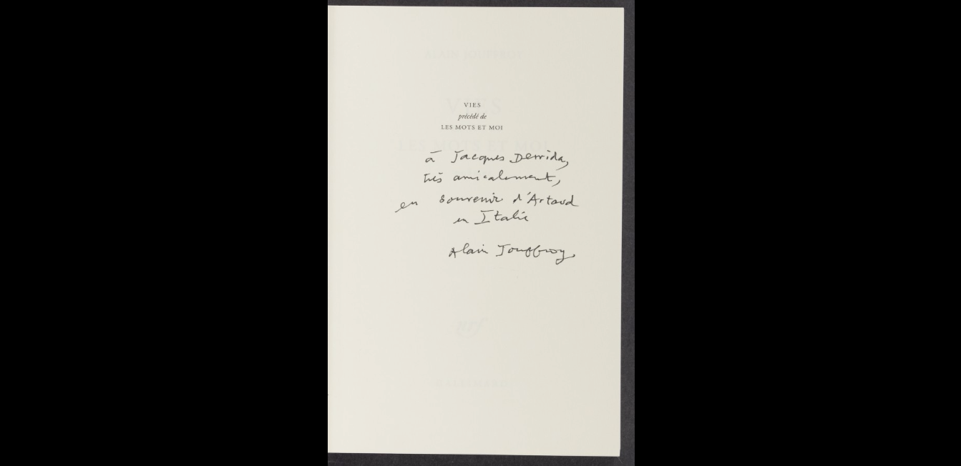
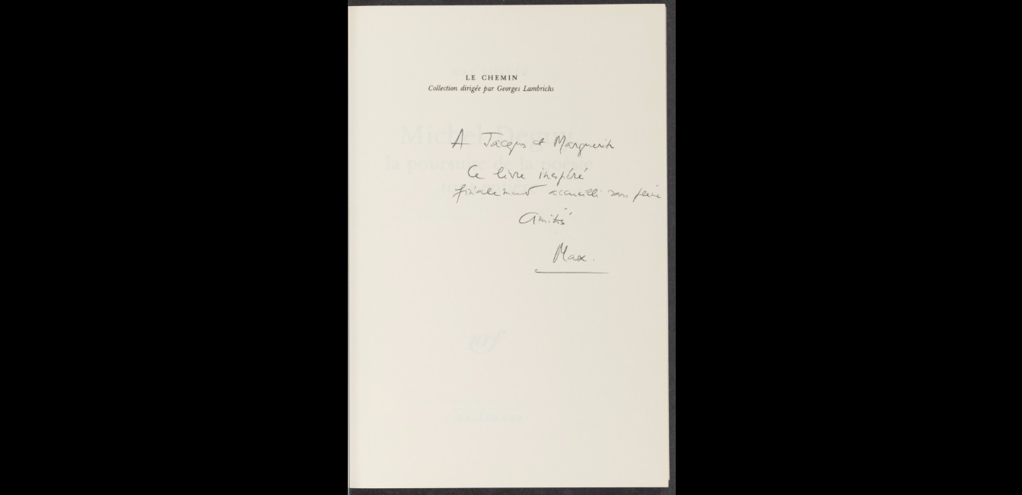
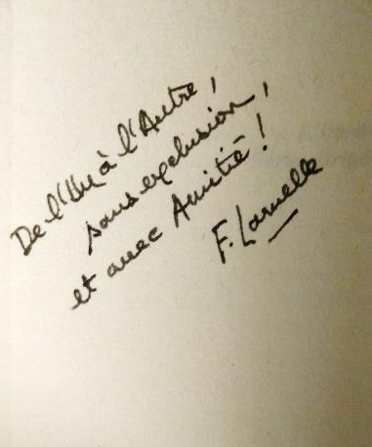
Notes:
For this project, we selected circa 500 items dedicated to Derrida by others. (This is a random sampling--though we did filter out living gifters in order to be sensitive to privacy concerns).
The goal of our project is to explore and develop a production-oriented workflow that allows for viable cataloging that not only captures but makes discoverable the relationships embedded in the dedications. To that end, we have been working at creating a data set that combines, in linked open data format, bibliographic item data (BIBFRAME ITEM) and entified dedication data.

Slide 6
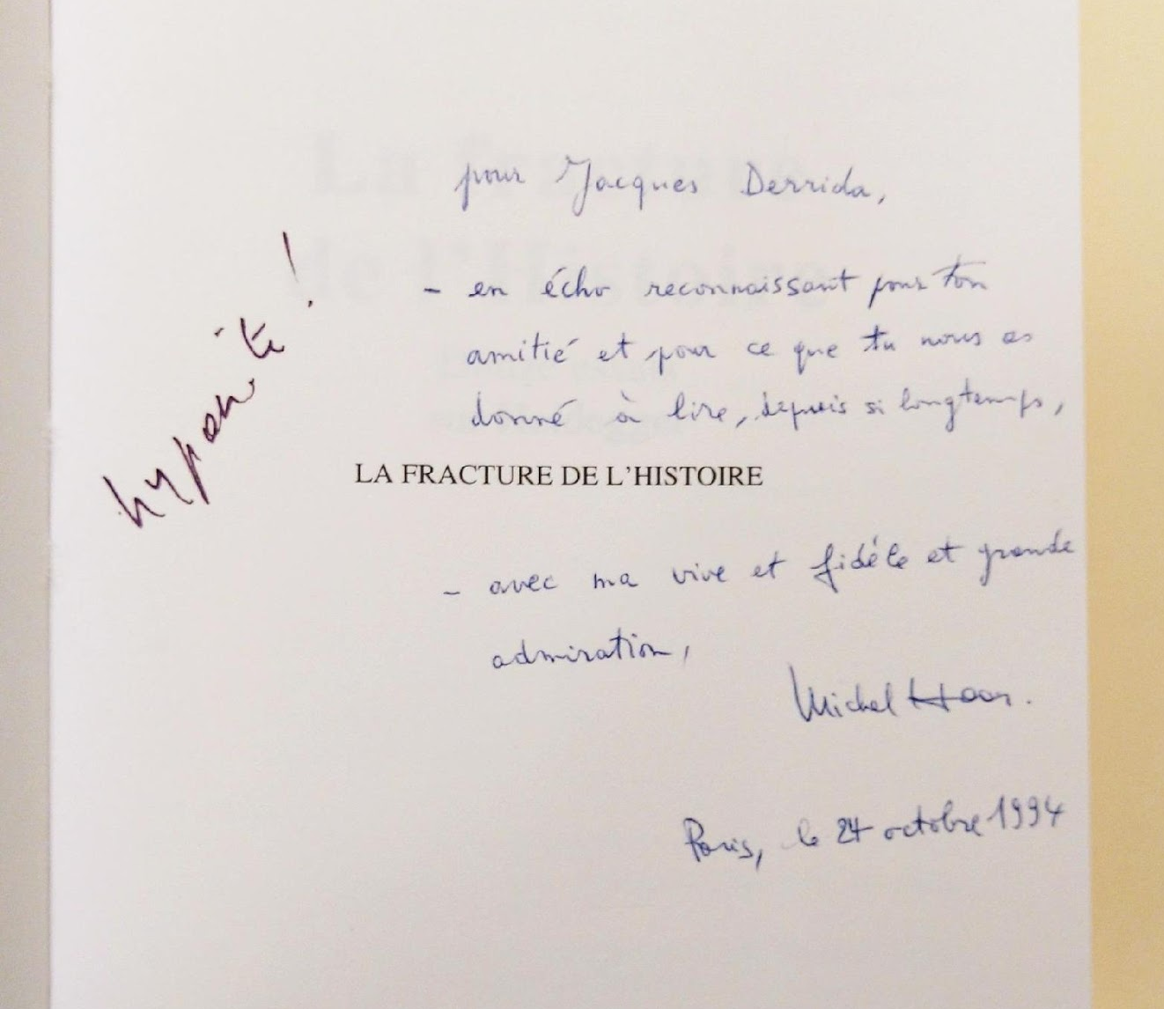
Notes:
This is a particularly amusing example because Derrida has annotated a--rather warm and cordial--dedication with the--rather less favorable--response “hypocrite”. It’s also therefore very interesting as a case of a meta-annotation. I’ll proceed using this example to explain our data model.
rougly, “
for Jacques Derrida, - in gratitude for your friendship and for what you have given us to read, for so long, THE FRACTURE OF HISTORY - with my strong and faithful and great admiration
“

Slide 7
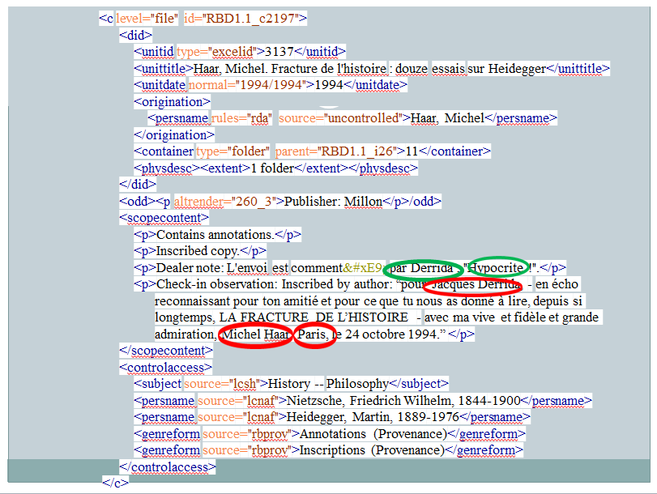
Notes:
As mentioned before, we currently describe this collection in a finding aid, not in individual MARC records.
This is a snipped of the XML in Encoded Archival Description, the archival data standard .
You notice the big blob of text in the center, which is a series of notes describing the dedication and Derrida’s annotation thereof. The data is completely unstructured—the entities are embedded in strings. (Similar in MARC note field.)
I’ve circled the low-hanging fruit here. One could go a step further and entify the work title and the date.

Slide 8
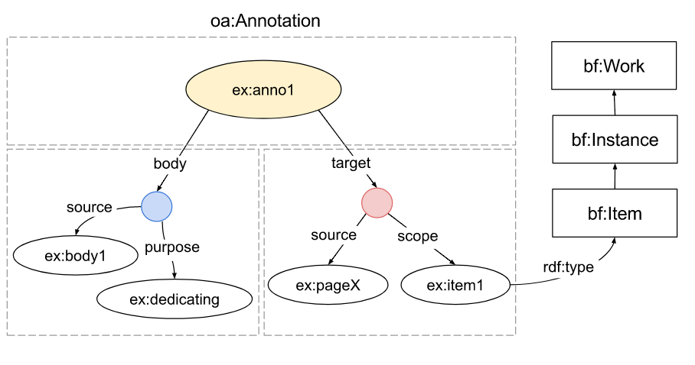
Notes:
We developed a data model to structure this data. Based on W3C Web Annotations. (recommendation)
The Web Annotations Model models relationships between information objects. (Those of you who attended the IIIF workshop yesterday have heard this before.) It was designed to model born-digital annotations that reference web-based targets (as opposed to physical data carriers), but it actually generalizes well to a library environment where a catalog record references information on the physical item (and won’t necessarily include a digital surrogate).
The spec: “An annotation is considered to be a set of connected resources, typically including a body and target, and conveys that the body is related to the target. The exact nature of this relationship changes according to the intention of the annotation, but the body is most frequently somehow “about” the target.”
This of course is equally true for our stringy dedications in the books from Derrida’s Library, where the annotation (the metadata package provided by catalogers) references a “body” (the content of the dedication) on a “target” (the physical data carrier or its digital surrogate).
As you can see on the right, conceptually the target hooks nicely into the existing BIBFRAME structure.
The idea for using Web Annotations came out of conversations with Tim Cole and others (who may be in this room) and was developed and published (Journal of Library Metadata) by my colleagues (and former colleague) Tim Thompson, Jennifer Baxmeyer, Joyce Bell, & Peter Green.

Slide 9
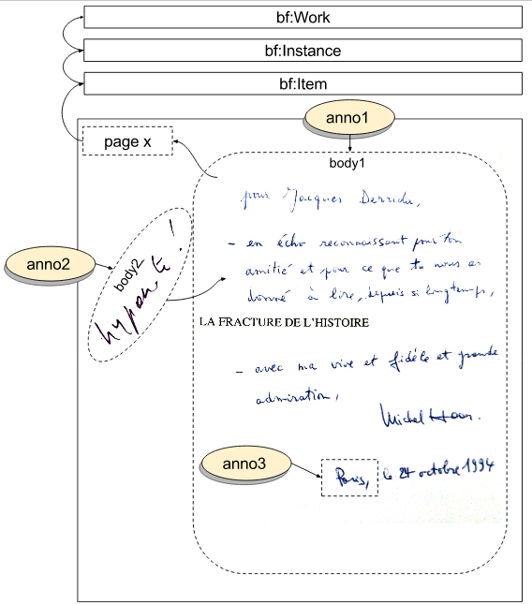
Notes:
Applying this model to the hypocrite annotation and meta annotation, we see here our anno1 (the information package regarding the dedication) and anno2 (the information package regarding the comment on the dedication).
(We also see here an anno3, an information package describing our entification activities, in this case of the place name.)

Slide 10
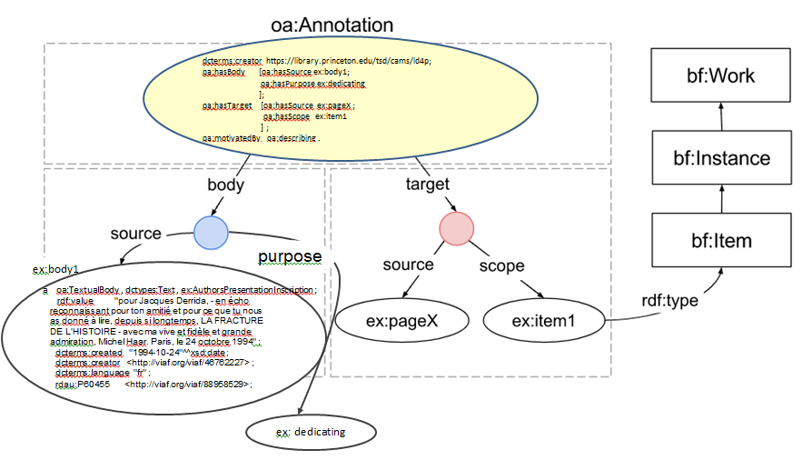
Notes:
If I start plugging in some data, this is what it would look like for anno1. Anno1 hasBody body1 (the text of the dedication) and hasTarget pageX (I neglected to look up the actual page number). PageX hasScope item1, which is our bf:Item. The purpose of body1 in anno1 is dedicating.
Anno2 (hypocrite) would have hasBody body2 and hasTarget/hasSource body1.

Slide 11
ex:anno2
a oa:Annotation ;
dcterms:creator <https://library.princeton.edu/tsd/cams/ld4p> ;
oa:hasBody ex:body2 ;
oa:hasTarget [ oa:hasSource ex:body1 ;
oa:hasScope ex:anno1 , ex:pageX , ex:item1
] ;
oa:motivatedBy oa:describing .
ex:body2
a ex:Annotation , oa:TextualBody , dctypes:Text ;
rdf:value "hypocrite!" ;
dcterms:creator <http://viaf.org/viaf/88958529> ;
dcterms:language "fr" ;
oa:hasPurpose oa:commenting .
Notes:
…and encoded anno2 would look like this (body2 (i.e. the text of “hypocrite”) has the purpose of commenting on target body1 (i.e. the text of the dedication).

Slide 12
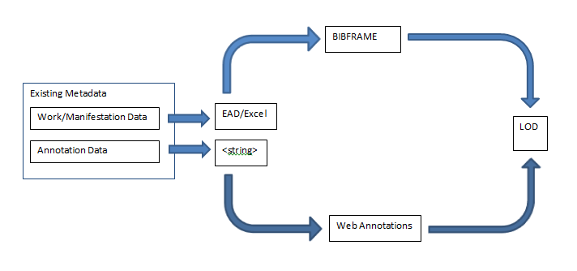
Theoretical Roadmap
Notes:
This is a very simplified view of how we created and consolidated the bibliographic and annotation data into a linked data record.
In simple terms, we started with two data sources, the data for the bibliographic item and the data for the dedication. (That’s already a rosy view, but bear with me.) We modeled one in BIBFRAME and the other in Web Annotations (I’m taking liberal shortcuts here), put both through their respective sausage makers, and voila got a consolidated resource record expressed as linked data at the end.

Slide 13
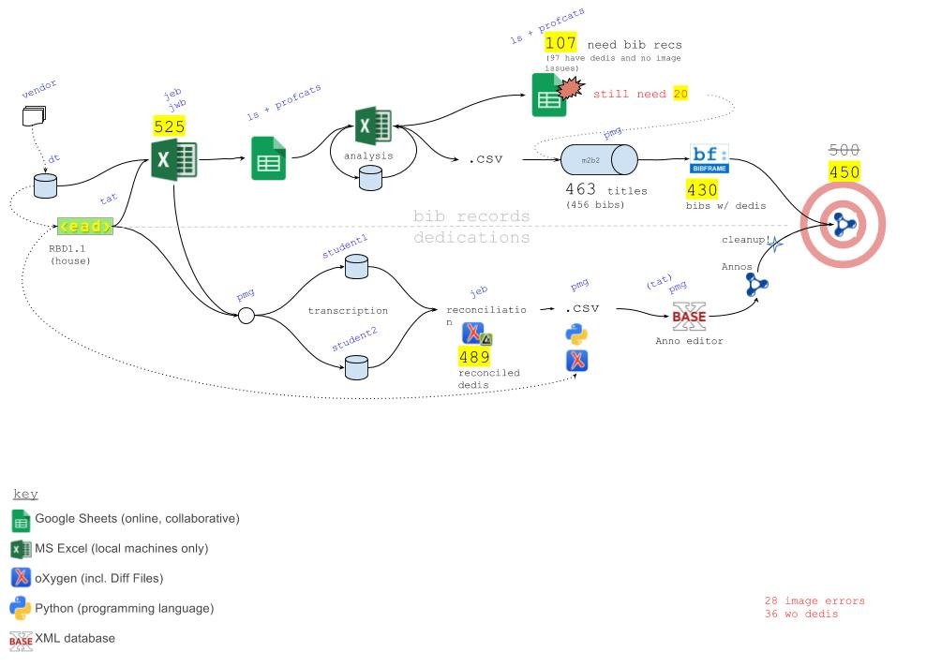
Actual Data Acrobatics
Notes:
This is the non-romanticized version, in Peter Green’s retrospective analysis of all the steps we actually had to take.
Details not important, just the fact of multiple contortions we had to twist ourselves and our data into.
I will mention, however, that for example, we had to go through MARC to get to BIBFRAME because as of yet we cannot produce BIBFRAME natively, and that we also ended up having to make our own editor to be able to create records for the annotations.

Slide 14
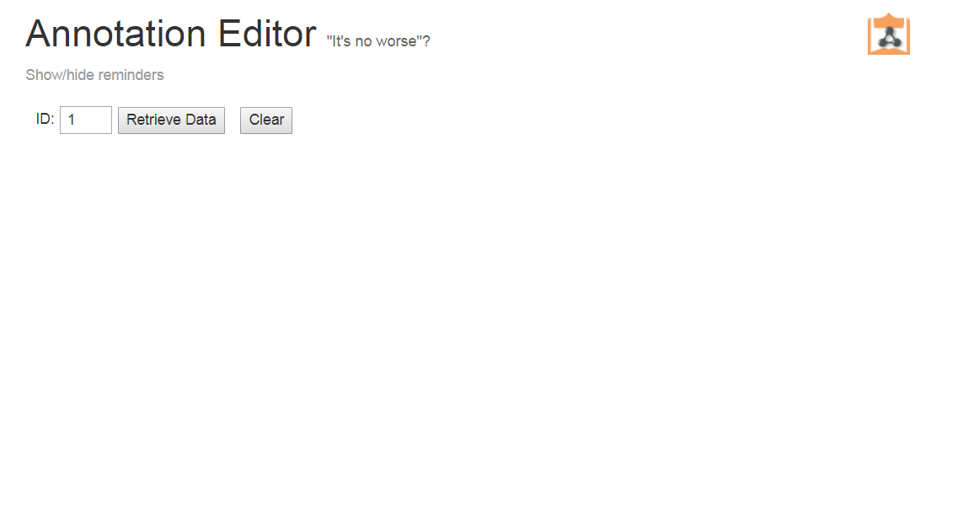
“MacGyver Ware” Data Editor
Notes:
This is that editor.
It’s a tool Peter Green built for us so we could move forward, since our timeline didn’t sync up with the development of the editing tools being developed by LD4-L.
It is not intended as a community tool but as an internal one-off, hence Peter’s deprecating nickname for it.
It is basic: E.g., can’t (yet) accommodate meta-annotations, except manually.
This is the landing page.

Slide 15
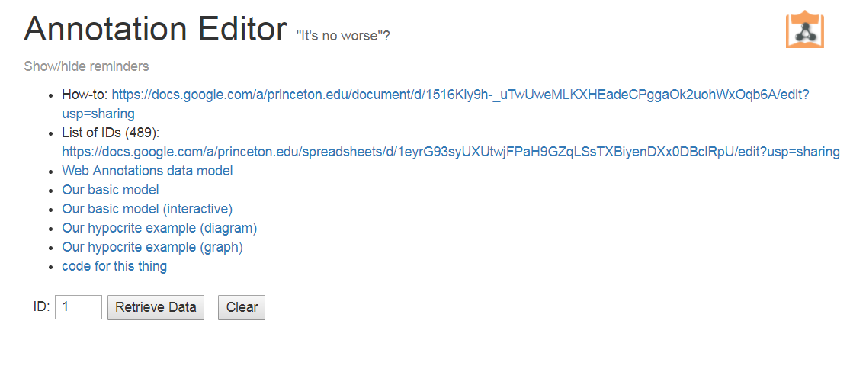
Notes:
Landing page with expanded reminders/instructions. (This assumes cataloging staff with no special LD background.)
For this project, we’re starting from a prepared data set of 489 records retrievable by ID number.

Slide 16
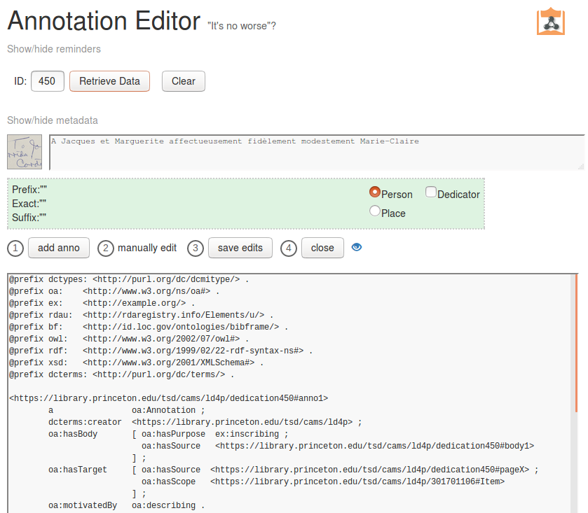
Notes:
I’ve retrieved record #450 (randomly). It shows an image of the dedication as present on the original (you can open it up), a text box with the transcription, an “entification” box (which we’ll use in a sec), and the code template. Also the work steps.
[Won’t show fuller template in the interest of time…]

Slide 17
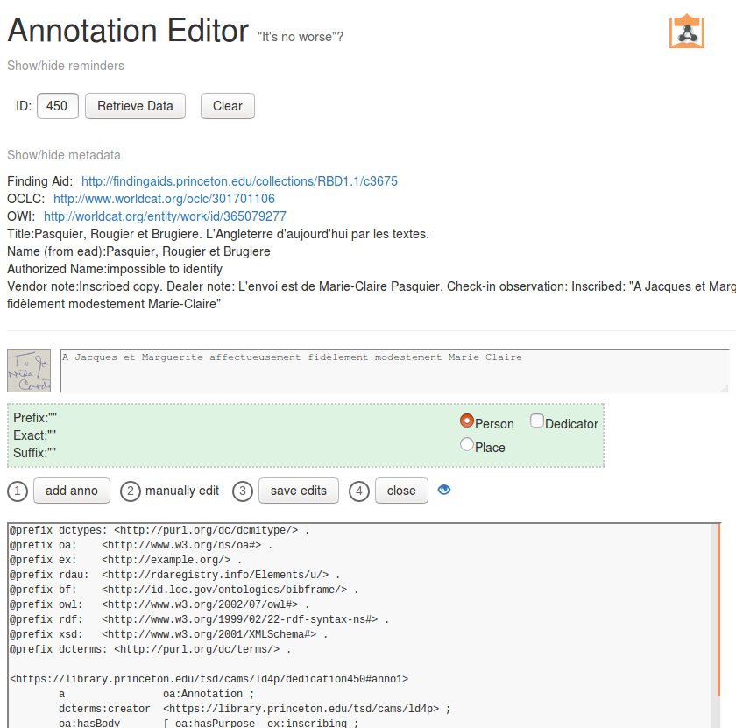
Notes:
View metadata of the bibliographic item (from various data sources)

Slide 18
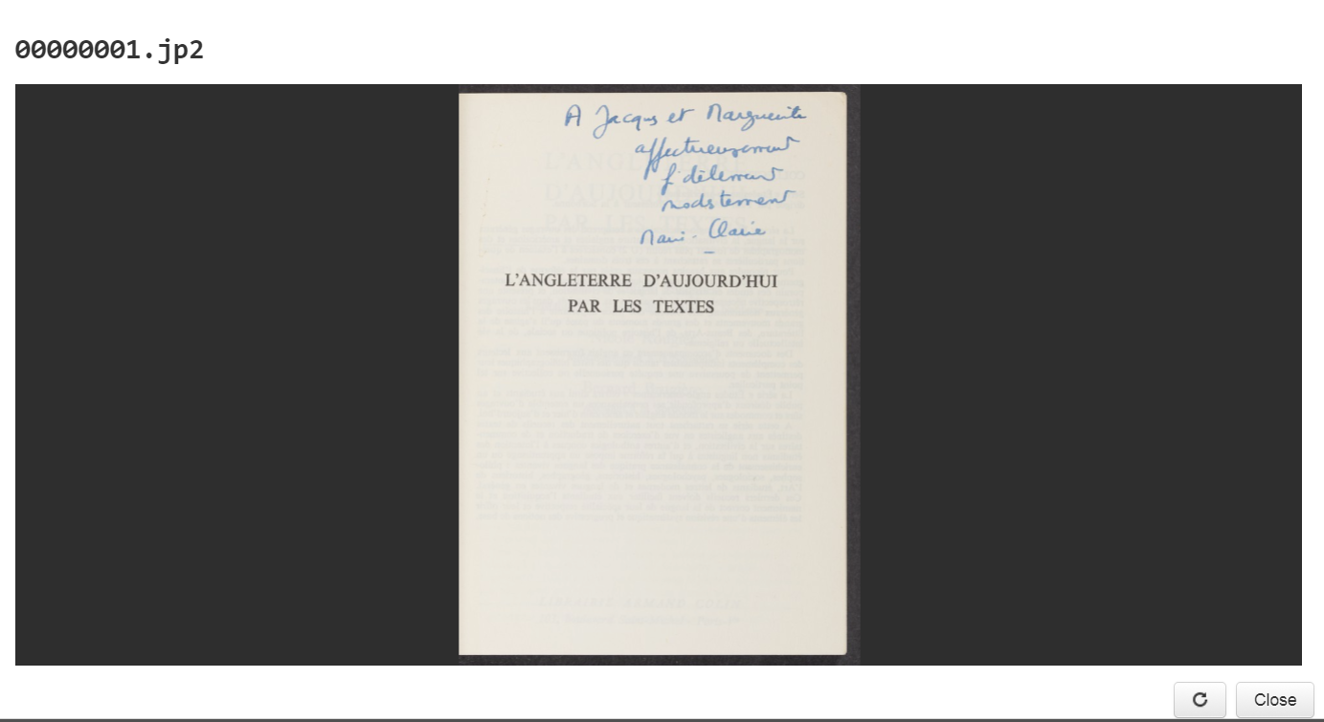
Notes:
View image of the annotation

Slide 19
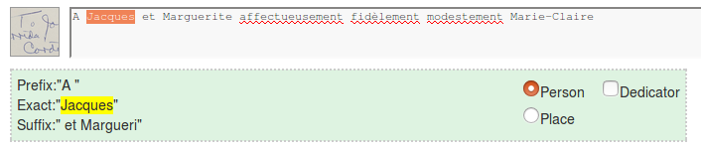
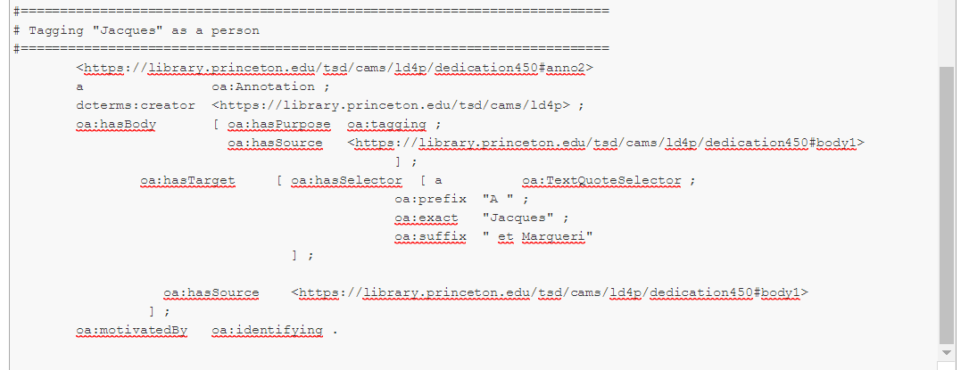
Notes:
Begin to entify: highlight name (will populate text fields below, with 12 chars of surrounding text--select person or place), click “add anno”.
See code below being appended to template. (ttl)
No natural language parsing (maybe in the future)

Slide 20
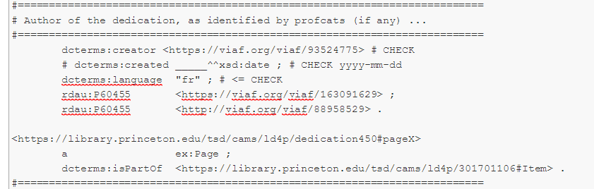
Notes:
Next step is to manually edit the template.
The dedicatee is prepopulated in the template (it’s assumed to be Jacques Derrida). Add a line for Marguerite.(Now part of the template) (rda properties) (Also tag M. in a second pass, not shown here)
The author of the dedication (dcterms:creator) is the translator Marie-Claire Pasquier, which we know from the EAD record (and ultimately the dealer information it was repurposed from).
Date is not known, so done. Save/close.

Slide 21
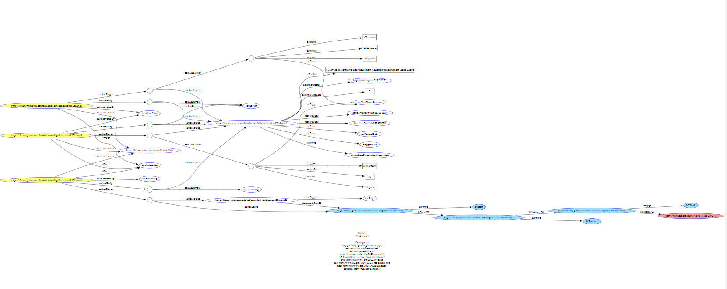
Notes:
View resulting (Graphiz) graph:
Graph gets instantly updated with each (saved) data change.
<Not sure anyone will be able to read this…>
Blue bubbles: BIBFRAME (red = OCLC work record)
Yellow bubbles: PUL’s annotations. One is motivated by describing (the body of which has the purpose of inscribing); the other two (where I tagged the names) are motivated by identifying (and the body in those cases has the purpose of tagging).

Slide 22
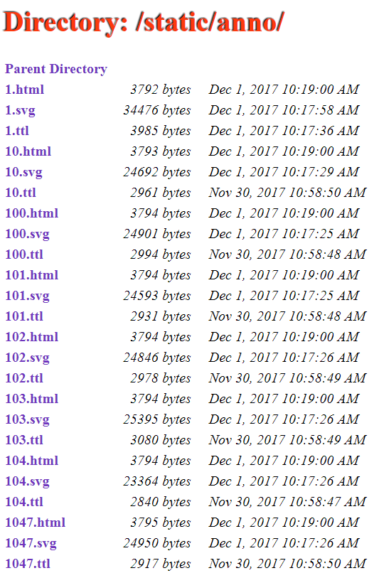
Notes:
The editor outputs three files. Currently, everything lives on the file system (no triplestore)
jquery.graphiz-svg - for generating interactive graphs
inotify - automatically (re)generate graphs after each edit

Slide 23
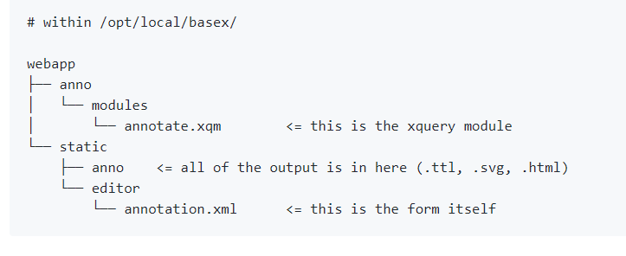
Notes:
There are two main files to work with
annotation.xml (form)
annotate.xqm (xquery module)
Will make tool available for those interested at some point in the future

Slide 24
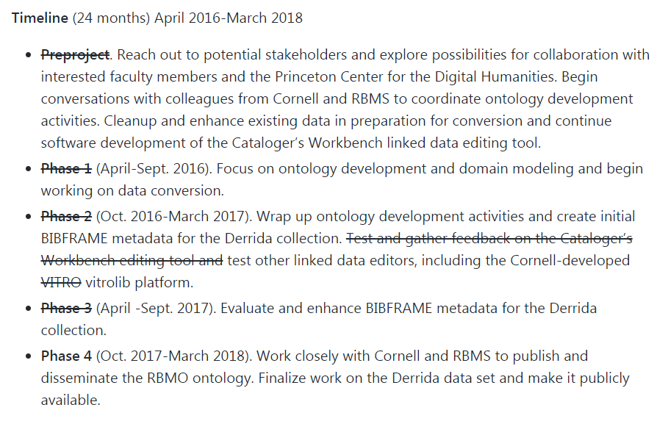
Challenges and Lessons Learned
Notes:
A final note on our journey.
When we first started the project, we quite underestimated the challenges ahead, and as a result, our initial lofty goals--which you see here in our original grant timeline--had to be scaled back and/or changed.
Two major components of this work ended up taking a lot more time than we expected, both in terms of what we could accomplish internally and at what pace the work of other groups progressed that our progress depended on. Those two things are data modeling (which took us a long time) and authoring editing tools (which we thought would happen externally in time for us to make use of the tools, but the project timelines didn’t converge that way and so we had to divert time and resources to build a stopgap one).
Other roadblocks for us included staffing issues and loose project management. (Probably all familiar with this type of issue).
What that meant for us was that we had to give up on goals like continued work on the Cataloger’s Workbench editor, our use of VITROlib and bibliotek-o., and our involvement in raremat and other ontology development initiatives.

Slide 25

Thank You
Regine: heberlei@exchange.Princeton.EDU
Joyce: joyceb@exchange.Princeton.EDU
Jennifer: bax@exchange.Princeton.EDU
Peter: pmgreen@exchange.Princeton.EDU
Lidia: lsantare@exchange.Princeton.EDU
Notes:
Next steps for us are refining the production workflow on our test data set using our in-house tool and publishing the data set.

Slide 26
Princeton copy inscribed on title page in ink: “pour Jacques Derrida, - en écho reconnaissant pour ton amitié et pour ce que tu nous as donné à lire, depuis si longtemps, LA FRACTURE DE L’HISTOIRE - avec ma vive et fidèle et grande admiration, Michel Haar. Paris, le 24 octobre 1994.”
Haar, Michel, 1937-2003, |e inscriber. |0 (viaf)46762227
Derrida, Jacques, 1930-2004, |e former owner. |0 (viaf)88958529
Notes:
Since I’m referencing MARC on the EAD slide, I’ll just keep this lying around in case someone asks...

